Slide 1

Sentiment Analysis For Marketing
Team Members:
1.Rajavarman.A
2.Ramprawin.U
3.Vishwa.P
4.Surya.R
5.Vishal.S

Slide 2
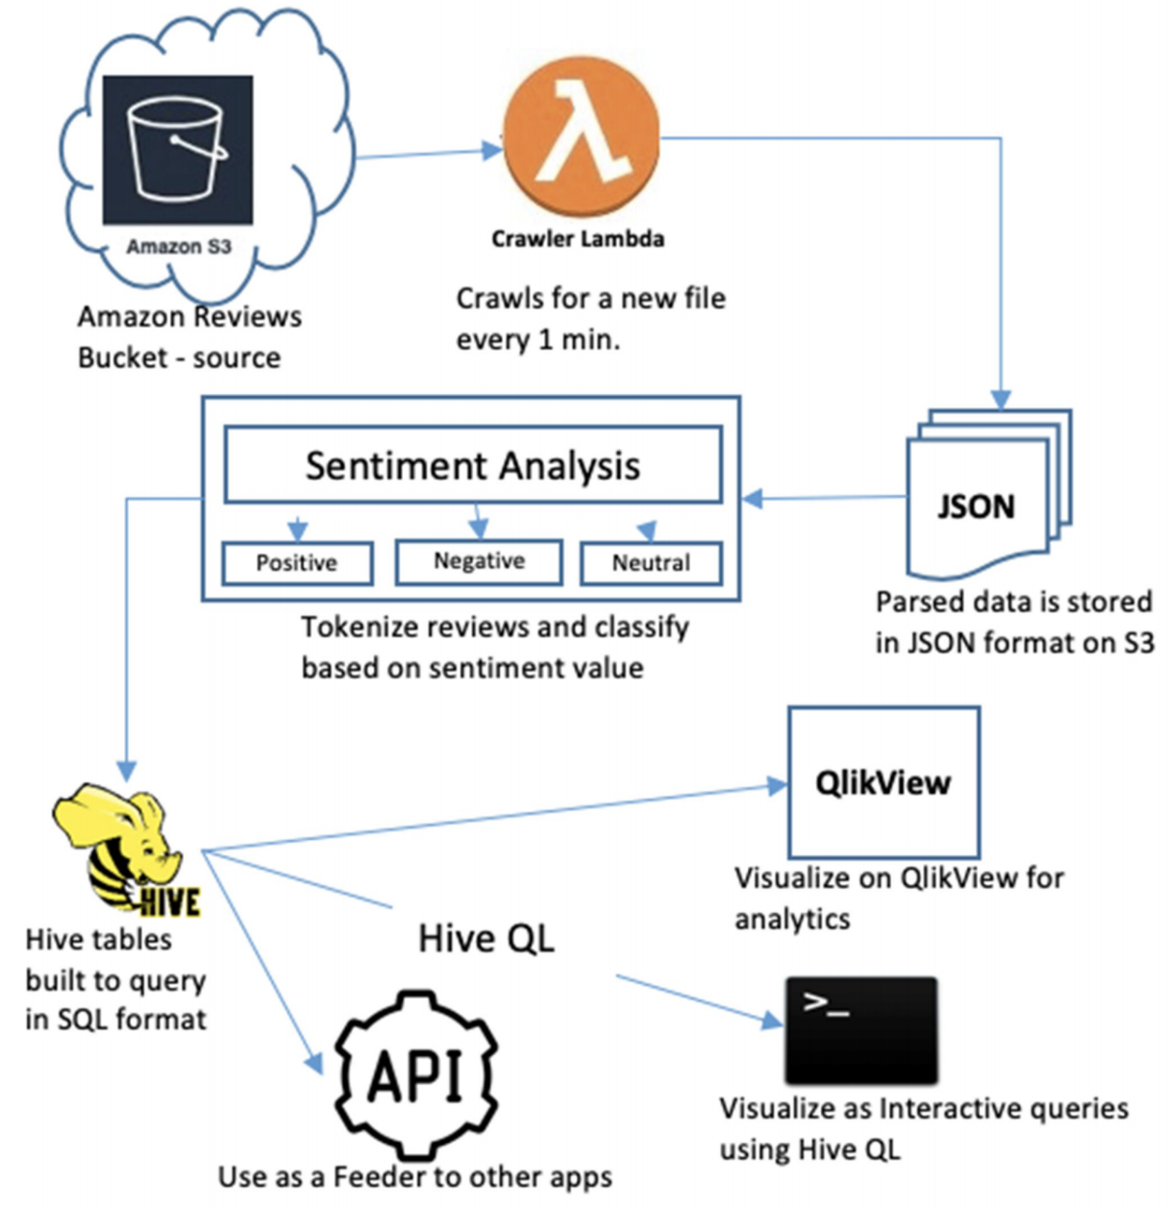

DATASET
One of the most important problems in e-commerce is the correct calculation of the points given to after-sales products. The solution to this problem is to provide greater customer satisfaction for the e-commerce site, product prominence for sellers, and a seamless shopping experience for buyers. Another problem is the correct ordering of the comments given to the products. The prominence of misleading comments will cause both financial losses and customer losses. In solving these 2 basic problems, e-commerce site and sellers will increase their sales, while customers will complete their purchasing journey without any problems.This dataset consists of ranking product ratings and reviews on Amazon
2

Slide 3

Load Required Libraries And Data Cleaning :
import pandas as pd
import matplotlib.pyplot as plt
import seaborn as sns
import numpy as np
df = df.drop(columns=['Unnamed: 0'])
df.head()
df.rename(columns={
'overall': 'userScore'
}, inplace=True)
df.head()
col = ['reviewText', 'userScore']
df = df[col]
df.head()
fig, ax = plt.subplots(nrows=1, ncols=2, figsize=(12,5))
sns.histplot(data=df, x='userScore', ax=ax[0]).set_title('histogram plot')
sns.kdeplot(data=df, x='userScore', ax=ax[1]).set_title('KDE plot')
plt.tight_layout()
plt.show()
3

Slide 4
EDA:
df_sent = df.copy()
import nltk
test = df_sent['reviewText'][5]
token_test = nltk.word_tokenize(test)
test_pos_tag = nltk.pos_tag(token_test[:5])
test_pos_tag
from nltk.sentiment import SentimentIntensityAnalyzer
sarcasm_text = 'yeah, way to wear a raincoat genius'
sia = SentimentIntensityAnalyzer()
sia.polarity_scores(sarcasm_text)
from transformers import AutoTokenizer
from transformers import AutoModelForSequenceClassification
from scipy.special import softmax
MODEL = f"cardiffnlp/twitter-roberta-base-sentiment"
tokenizer = AutoTokenizer.from_pretrained(MODEL)
model = AutoModelForSequenceClassification.from_pretrained(MODEL)
encoded_text = tokenizer(sarcasm_text, return_tensors='pt') # a structure that algoritm will understand
encoded_text
output = model(**encoded_text)
output
roberta_sarcasm = {
'roberta_pos': softmax(scores)[0],
'roberta_neu': softmax(scores)[1],
'roberta_neg': softmax(scores)[2],
}
roberta_sarcasm
3

Slide 5
Test Sarcasm on Vader and Roberta:
def roberta_score(review):
encoded_text = tokenizer(review, return_tensors='pt')
output = model(**encoded_text)
scores = output[0][0].detach().numpy()
scores = softmax(scores)
scores_dict = {
'roberta_neg': scores[0],
'roberta_neu': scores[1],
'roberta_pos': scores[2],
}
return scores_dict
res = {}
for i, row in df.iterrows():
try:
text = row['reviewText']
my_id = row['id']
roberta_score_result = roberta_score(text)
score_ = {**roberta_score_result}
res[my_id] = score_
except RuntimeError:
print(f'comment is too long for Roberta to handle for id {my_id}')
df_roberta = pd.DataFrame(res).T
df_roberta
df_roberta.reset_index(inplace=True)
df_roberta
df_sent = pd.merge(df, df_roberta, how='inner', left_on='id', right_on='index')
df_sent
df_sent.sort_values(by='roberta_pos', ascending=False).values[0]
df_sent.sort_values(by='userScore', ascending=True).values[0]
df_sent.sort_values(by='roberta_neg', ascending=False).values[0]
fig, ax = plt.subplots(nrows=1, ncols=3, figsize=(12,5))
sns.histplot(data=df_sent, x='roberta_pos', ax=ax[0]).set_title('Roberta Positive')
sns.histplot(data=df_sent, x='roberta_neu', ax=ax[1]).set_title('Roberta Neutral')
sns.histplot(data=df_sent, x='roberta_neg', ax=ax[2]).set_title('Roberta Negative')
plt.tight_layout()
plt.show()
3

Slide 6
Validate Roberta Sentimental Score with Amazon Score Review:
df_amazon_neg = df_sent.query('userScore < 3.0')
df_amazon_neu = df_sent.query('userScore == 3.0')
df_amazon_pos = df_sent.query('userScore > 3.0')
print(f'amazon negative review is {df_amazon_neg.shape[0]}')
print(f'amazon neutral review is {df_amazon_neu.shape[0]}')
print(f'amazon positive review is {df_amazon_pos.shape[0]}')
amazon negative review is 318
amazon neutral review is 141
amazon positive review is 4437
fig, ax = plt.subplots(nrows=1, ncols=3, figsize=(12,7))
sns.kdeplot(data=df_amazon_neg, x='roberta_pos', ax=ax[0], label='pos').set_title('Amazon Negative Review')
sns.kdeplot(data=df_amazon_neg, x='roberta_neu', ax=ax[0], label='neu').set_title('Amazon Negative Review')
sns.kdeplot(data=df_amazon_neg, x='roberta_neg', ax=ax[0], label='neg').set_title('Amazon Negative Review')
sns.kdeplot(data=df_amazon_neu, x='roberta_pos', ax=ax[1], label='pos').set_title('Amazon Neutral Review')
sns.kdeplot(data=df_amazon_neu, x='roberta_neu', ax=ax[1], label='neu').set_title('Amazon Neutral Review')
sns.kdeplot(data=df_amazon_neu, x='roberta_neg', ax=ax[1], label='neg').set_title('Amazon Neutral Review')
sns.kdeplot(data=df_amazon_pos, x='roberta_pos', ax=ax[2], label='pos').set_title('Amazon Positive Review')
sns.kdeplot(data=df_amazon_pos, x='roberta_neu', ax=ax[2], label='neu').set_title('Amazon Positive Review')
sns.kdeplot(data=df_amazon_pos, x='roberta_neg', ax=ax[2], label='neg').set_title('Amazon Positive Review')
plt.tight_layout()
plt.legend()
plt.show()
# confirm with histogram plot
fig, ax = plt.subplots(nrows=1, ncols=3, figsize=(12,7))
sns.histplot(data=df_amazon_neg, x='roberta_neg', ax=ax[0])
sns.histplot(data=df_amazon_neg, x='roberta_neu', ax=ax[1])
sns.histplot(data=df_amazon_neg, x='roberta_pos', ax=ax[2])
plt.show()

Slide 7
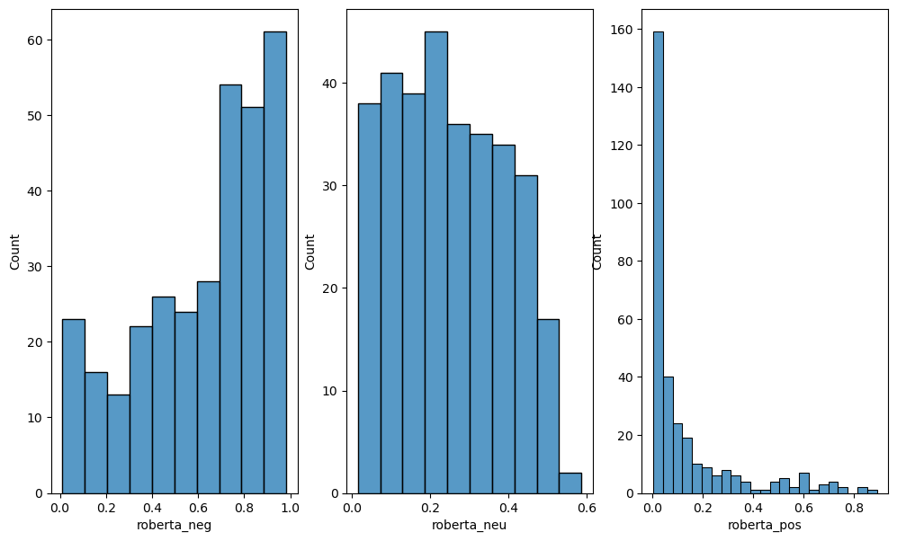
EXPLORATORY ANAYSIS 1:

Slide 8
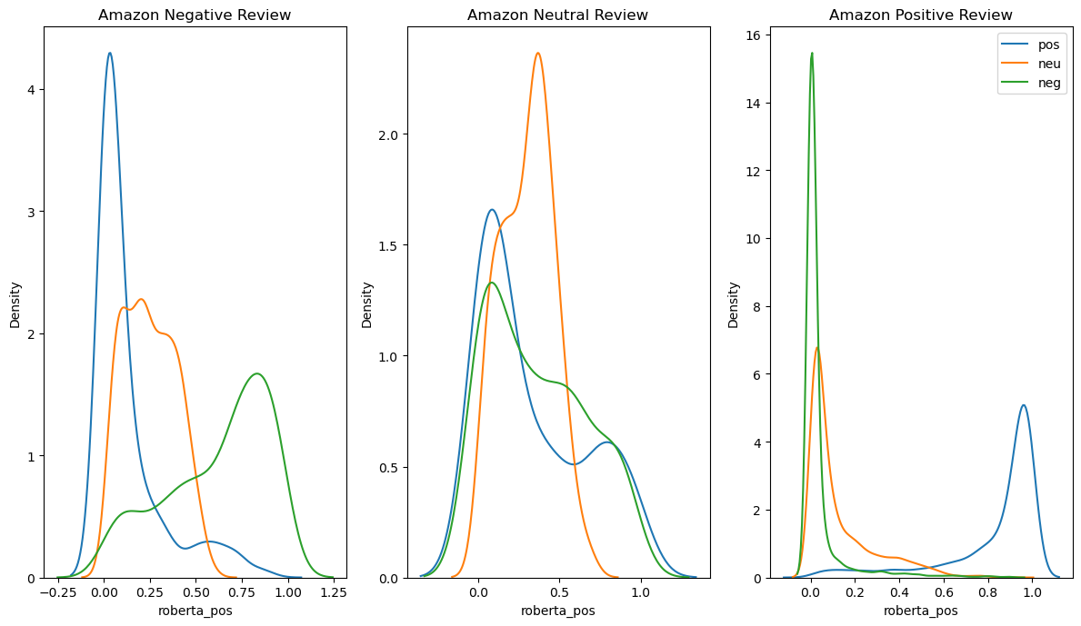
EXPLORATORY ANAYSIS 2:

Slide 9
THANK YOU

